Slide 1
JAVA – INHERITANCE types

Slide 2
TYPES OF INHERITANCE
SINGLE
MULTILEVEL
HIERARCHICAL
MULTIPLE
HYBRID
Notes:
Multiple and Hybrid inheritance is not applicable in JAVA

Slide 3
Guess the type!
class A
{
void m1()
{
}
}
class B extends A
{
void m2()
{
}
}
Extends from only one class!

Slide 4
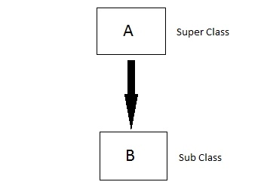
1) Single Inheritance

Slide 5
Guess the type!
class A
{
void m1()
{
}
}
class B extends A
{
void m2()
{
}
}
class C extends B
{
void m3()
{
}
}
Class C extends from B and Class B extends from A

Slide 6
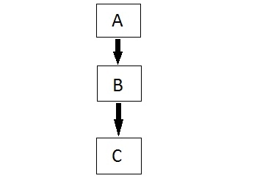
2) Multilevel Inheritance

Slide 7





Single inheritance
multilevel inheritance
Rich!

Slide 8
Guess the type!
class A
{
void m1()
{
}
}
class B extends A
{
void m2()
{
}
}
class C extends A
{
void m3()
{
}
}
Class C extends from A and Class B extends from A

Slide 9
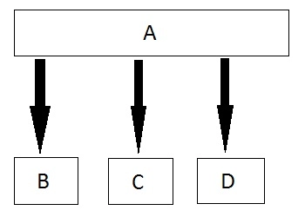
3) Hierarchical Inheritance

Slide 10



Slide 11
WHY MULTIPLE INHERITANCE IS NOT SUPPORTED IN JAVA?

Slide 12
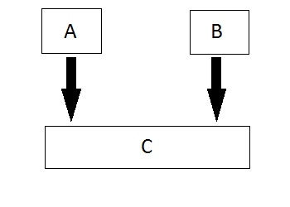
3) Multiple Inheritance

Slide 13



Class - Father
Class - Mother
Method: money
Method: money
AMBIGUITY!!!
THEREFORE MULTIPLE INHERITANCE NOT POSSIBLE IN JAVA!!
Want money??
Which one to access??

Slide 14
HYBRID INHERITANCE ALSO NOT POSSIBLE USING CLASSES!

Slide 15
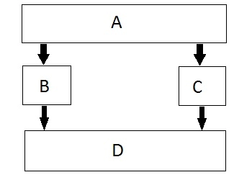
5) Hybrid (Virtual) Inheritance
Hybrid Inheritance is implemented by combining more than one type of inheritance.
Combining Hierarchical inheritance and Multiple Inheritance.

Slide 16
Hybrid
Multiple + hierarchical
Notes:
Since multiple inheritance is not applicable in java, hybrid which is combination of multiple and hierarchical is also not possible.

Slide 17
class A
{
public
int a = 10;
}
class B extends A
{
public
int b = 20;
}
class C extends B
{
public
void disp()
{
System.out.println(a+b);
}
}
public class D extends B
{
public
void disp()
{
System.out.println(a-b);
}
public static void main(String args[])
{
D d = new D();
d.disp();
C c = new C();
c.disp();
}
}
This is an example of combination of multilevel and hierarchical inheritance
HYBRID INHERITANCE with multilevel and hierarchical
Is possible!!
Output:
-10
30
Notes:
Therefore, hybrid inheritance involving multiple inheritance alone is not supported in java.

Slide 18
IN JAVA EVERY CLASS HAS A PARENT CLASS EXCEPT??
OBJECT CLASS

Slide 19


